Slide 1

Title of the book
TECH 105 Introduction to Engineering Technology
Presented by: Joe Tabas
Notes:
Hello and welcome to my presentation of the book….(Book Title)
My name is Joe is Joe Tabas and today I will discussing the stories…(Story Titles)

Slide 2
Title of Story 1
Name of story 1
Reason you have selected the story
Add several key points about the story
Maybe include a picture if appropriate
Notes:
A sentence or two about the first story you selected.
A sentence or two about why you chose this story
Then have a paragraph or two about the story. Use the bullet points you made in the slide to tie it all together.

Slide 3
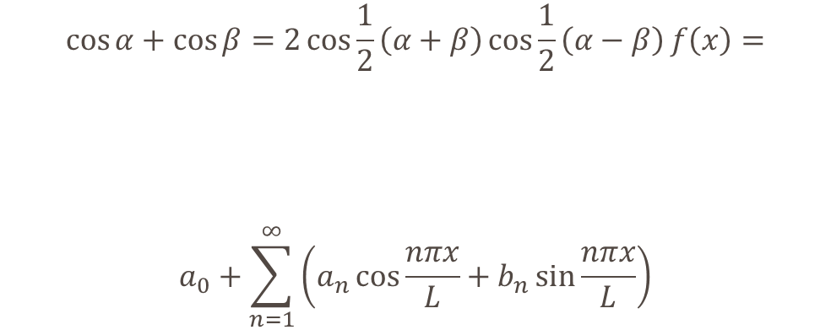
Use an Appropriate Title
What we now know is that…
There are several new technologies…
The body of scientific knowledge recently expanded providing new insight into …
$$\cos{α}+\cos{β}=2\cos{\frac{1}{2}\left(α+β\right)}\cos{\frac{1}{2}\left(α−β\right)}f\left(x\right)=$$
$$a_{0}+\sum_{n=1}^{∞}{\left(a_{n}\cos{\frac{nπx}{L}}+b_{n}\sin{\frac{nπx}{L}}\right)}$$
Notes:
Type what you would about the research you have conducted that relates to your stories problem

Slide 4
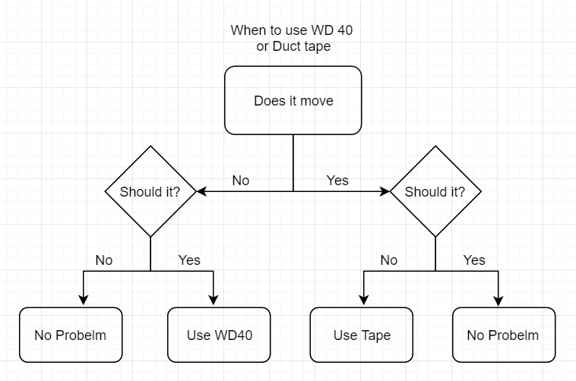
Add title
Notes:
Here is the process I used to begin my design process. As you can see, I needed to start with problem identification then I could determine if a problem existed and the best approach to solving it. This is the most important step because….

Slide 5
Phase 0 Concept Evaluation
Make a list of initial thoughts
Include all possible solutions you might have had
Remember the lecture and think about the train and the mountain
Review the lecture/textbook material and tie it in here as well
Notes:
Discuss in great detail what your possible solutions could be. Brainstorming should be evident here as well as further potential research.

Slide 6
Phase 1 Planning and Specifications
Show a more realistic list of potential solutions here
Notes:
Consider all aspects of your proposed potential solutions. Include ethical theories and perspectives that would exclude some of you considerations
Include possible sources of error that would result in likely failures of some of the proposed solutions. Again this section should be highly detailed.

Slide 7
Phase 2 Development
List your two possible sources plan A and plan B
Provide the key point on why which is solution is part A
Notes:
Here you have narrowed the list down to plan and plan B. Discuss in detail, why these two are the best choices based on the pool of choices you had on the previous slide.

Slide 8
Phase 3 Test and Evaluation
List the testing procedures here.
List some details about the tests you would use
Notes:
Provide a detailed discussion about how you would test the design you have selected. What conditions would you test it in? For how long? And other considerations that apply to your design.

Slide 9
Phase 4 – Product Release
Create a slogan for your product
Include how you keep track of your solutions and ensure they are still working
Include a failure plan that in the event something is going wrong you will address the problem accordingly.

Slide 10
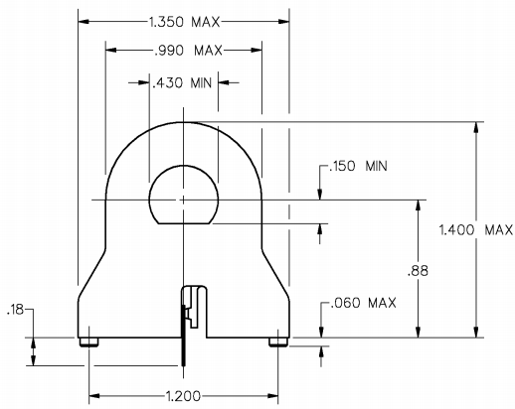
Notes:
If your design supports scaled drawings, system schematic or diagrams, use them. If not see the other image for process type image.

Slide 11
Title of Story 2
Name of story 1
Reason you have selected the story
Add several key points about the story
Maybe include a picture if appropriate
Notes:
A sentence or two about the second story you selected.
A sentence or two about why you chose this story
Then have a paragraph or two about the story. Use the bullet points you made in the slide to tie it all together.

Slide 12
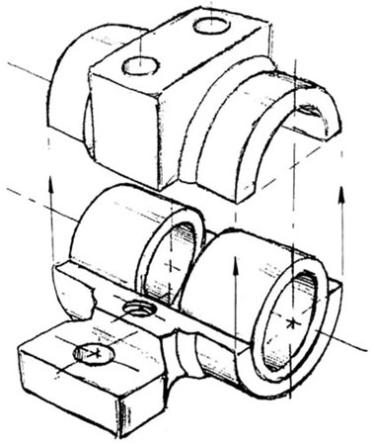
Use an Appropriate Title
What we now know is that…
There are several new technologies…
The body of scientific knowledge recently expanded providing new insight into …
Notes:
Type what you would about the research you have conducted that relates to your stories problem

Slide 13
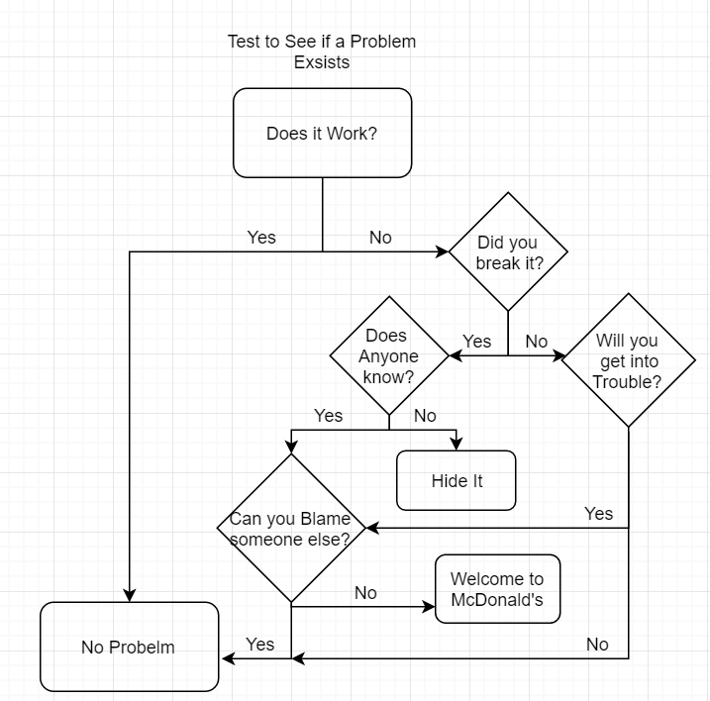
Add Title
Notes:
Here is the process I used to begin my design process. As you can see, I needed to start with problem identification then I could determine if a problem existed and the best approach to solving it. This is the most important step because….

Slide 14
Phase 0 Concept Evaluation
Make a list of initial thoughts
Include all possible solutions you might have had
Remember the lecture and think about the train and the mountain
Review the lecture/textbook material and tie it in here as well
Notes:
Discuss in great detail what your possible solutions could be. Brainstorming should be evident here as well as further potential research.

Slide 15
Phase 1 Planning and Specifications
Show a more realistic list of potential solutions here
Notes:
Consider all aspects of your proposed potential solutions. Include ethical theories and perspectives that would exclude some of you considerations
Include possible sources of error that would result in likely failures of some of the proposed solutions. Again this section should be highly detailed.

Slide 16
Phase 2 Development
List your two possible sources plan A and plan B
Provide the key point on why which is solution is part A
Notes:
Here you have narrowed the list down to plan and plan B. Discuss in detail, why these two are the best choices based on the pool of choices you had on the previous slide.

Slide 17
Phase 3 Test and Evaluation
List the testing procedures here.
List some details about the tests you would use
Notes:
Provide a detailed discussion about how you would test the design you have selected. What conditions would you test it in? For how long? And other considerations that apply to your design.

Slide 18
Phase 4 – Product Release
Create a slogan for your product
Include how you keep track of your solutions and ensure they are still working
Include a failure plan that in the event something is going wrong you will address the problem accordingly.

Slide 19
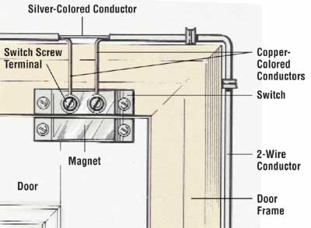
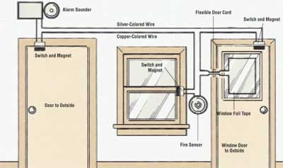
Notes:
If you cannot use a schematic, system or detailed design drawing, you can use something like this to show how it works.

Slide 20
Conclusion
Conclusion for Story 1
Conclusion for story 2
What was the problem you wanted to solve
What did others think was best
How did this impact your design process
What was your solution
How do you know it worked
What was the problem you wanted to solve
What did others think was best
How did this impact your design process
What was your solution
How do you know it worked
Notes:
Answer the questions in the slide here in the speaker notes. Separate each question and answer with numbers or bullet points in the speaker notes.

Slide 21
Final Thoughts
Conclusion Conclusion
Notes:
In this section you will need to identify future plans of the solutions. The goal here is continuous improvement. Statistics should be used as the evaluation to monitor the results of the solution. To see if the problem getting better or worse. You should also address the need to look for improved technologies, cost reduction and other ideas presented in the problem solving and statistics lectures.

Slide 22
References
References for Story 1
References for Story 2
Notes:
You do not need notes here, but be sure to use APA to list the sources you select!

